Slide 1







TIC TAC TOE
Presentation

Slide 2







TEAM
MARK WILSON BUNAG
RAILEY INDUCTIVO
MEMBER
MEMBER
JUNE LOUISE SABINO
LEADER
JHAVIELL GEDORIO
JOHN LLOYD HERNANDEZ
MEMBER
LEADER

Slide 3
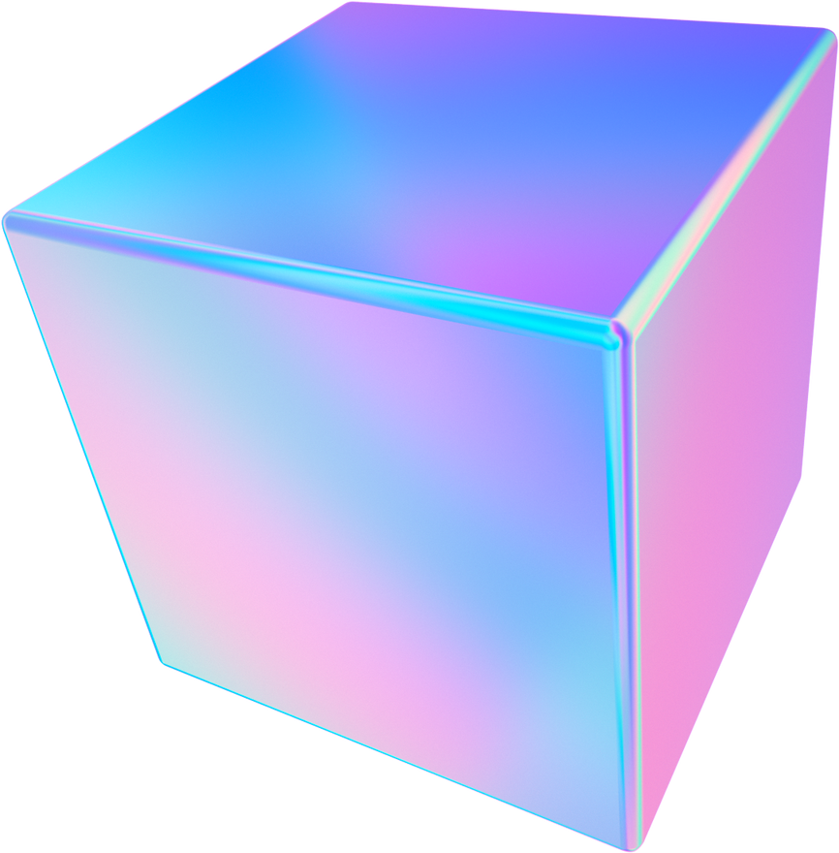

Introduction
Consider a world where strategic battles are played on a basic 3x3 grid, Xs and Os compete intellectually. The popular game of tic tac toe, which is played by both children and adults, continues to attract players everywhere. Its seeming simplicity belies a profound beauty; it is both a strategy and choice game and a demonstration of computer thinking power.
The importance of the project originates from its evaluation of the user experience and technological components of building a Tic Tac Toe gaming app. By using Java as the programming language and designing an appealing graphical user interface, the goal is to create a compelling and user-friendly application that captures the essence of the old game while giving a better digital experience.

Slide 4


Review of Related Literatures
Aditya, J. P. (2020).
Karamchandani et al. (2015).
Lincopinis et al. (2023).
Randomised fast no-loss expert system to play tic-tac-toe like a
human.
A simple algorithm for designing an artificial intelligence
based Tic Tac Toe game,
A Review on Java
Programming Language.

Slide 5

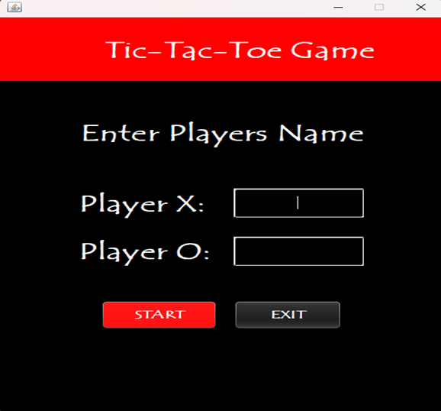
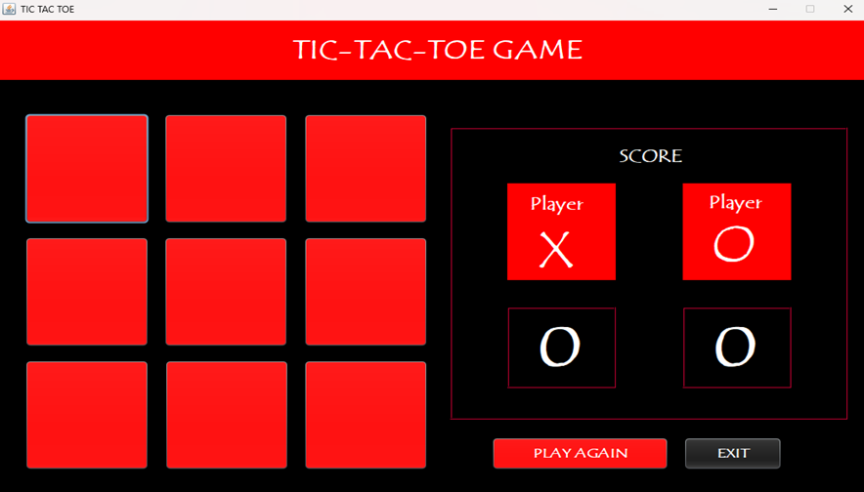
TIC TAC TOE
JAVA APP

Slide 6

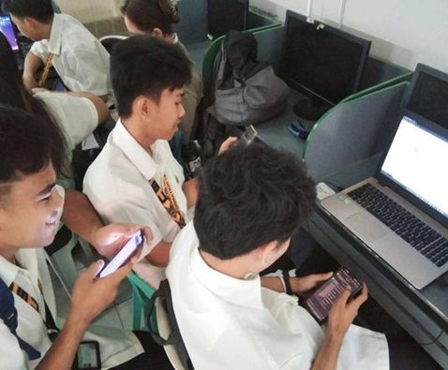
PHOTO DOCUMENTATION
We are collaborating on research and development of a Tic Tac Toe game app using Java programming and GUI.

Slide 7

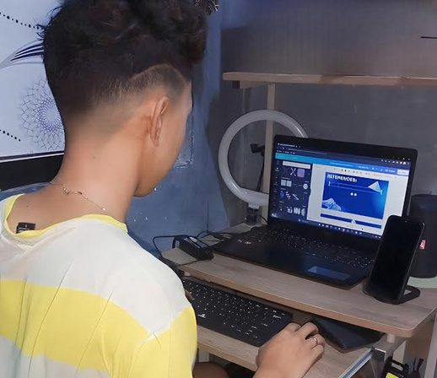
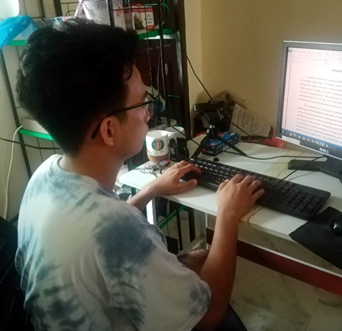
PHOTO DOCUMENTATION
We are actively engaged in researching and working together to create a Tic Tac Toe game app. Some are focused on finding related literature to enhance their understanding of game development principles and techniques.

Slide 8
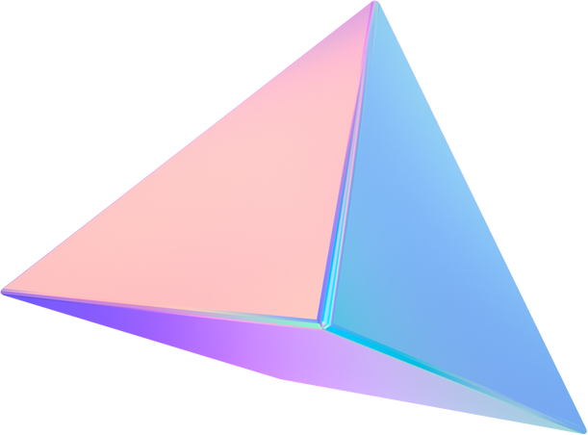

REFERENCES:
Aditya, J. P. (2020). Randomised fast no-loss expert system to play tic-tac-toe like a
human. Retrieved from: https://ietresearch.onlinelibrary.wiley.com/doi/full
/10.1049/ccs.2020.0018
DJ Oamen (2020). How to Create Advanced Tic Tac Toe Game in Java NetBeans.
Retrived from: https://www.youtube.com/watch?v=H9zadE3h_8E
Karamchandani et al. (2015). "A simple algorithm for designing an artificial
intelligence based Tic Tac Toe game," 2015 International Conference on
Pervasive Computing (ICPC). Retrieved from: https://openaccessjournals.eu
/index.php/ijiaet/article/view/219

Slide 9
Thank You

